Slide 1

Retail
Agentic Automation

Slide 2
Weekly Performance
Installs were % up WoW, up % YoY
Key Mobile App Metrics |  | Actuals | Forecast | WoW | YoY | QTD vs Forecast | YTD vs Forecast
Acquisition | Installs
 | Android
 | iOS
 | MAI Spend
 | Cost Per Install
Engagement | WAU – Amplitude
 | In-Store Session *
 | MAU (Feb) – Amplitude
Retention | 7 Day New User RR (WK05)**
 | 30 Day New User RR (WK 02)
Key Highlights
Comparative Performance | App |  |  | mWeb |  |  | Desktop
 | Weekly | WoW | YoY | Weekly | WoW | YoY | Weekly | WoW | YoY
Unique Visitors
Customers
Unique Visits
Orders
Conversion Rate
GMV
AOV

Slide 3


Installs Breakout
Overall installs increased by % WoW to M, is up % YoY.
Install Source |  |  | Installs from Source
Organic Installs
Owned Installs
Paid Installs
Total Installs

Slide 4
Owned Installs
Owned installs increase by % WoW to reach K.
Key Highlights
Top Contributing Owned Channels
Install Source | Weekly Installs | WoW Change

Slide 5






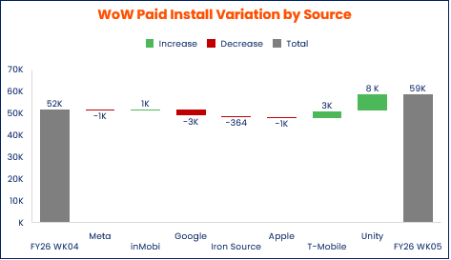
Paid MAI Installs
Paid Installs decreased % WoW to K, unchanged YoY.
Weekly Summary Metrics by Partner
Key Highlights
Weekly KPI |  |  |  |  |  |  |  | Total Attr.
Installs (+/- WoW)
(+/- WoW)
Spend (+/- WoW)
(+/- WoW)
CPI (+/- WoW)
(+/- WoW)
* Includes InMobi & Glance media partners

Slide 6
Paid MAE Engagement
K sessions were done at a CPA of $
Key Highlights
Breakdown by Audience & Partner
Platform |  |  |  |  |  |  | Total
Media Source |  |  |  |  |  |  | +
Audience | Predictive Churn | Low Activity | Predictive Churn | Low Activity | Predictive Churn | Low Activity
Sessions* (+/- WoW)
(+/- WoW)
Spend (+/- WoW)
(+/- WoW)
CPA* (+/- WoW)
(+/- WoW)
ROAS * (7 days) (+/- WoW)

Slide 7
Active Users: Weekly and Monthly Metrics (WAU & MAU)
WAU remain unchanged WoW, to M, up YoY.
Key Highlights
Key Highlights
312K
0M

Slide 8
Weekly App Net Growth
Total Active Users remained unchanged WoW, to reach M, up % YoY.
Key Highlights

Slide 9
Thank You

